Slide 1
Ethics
May 30, 2018

Slide 2
Replace “Physics” with your science
Each physicist is a citizen of the community of science.
Each shares responsibility for the welfare of this community.
Science is best advanced when there is mutual trust, based upon honest behavior, throughout the community.
Acts of deception, or any other acts that deliberately compromise the advancement of science, are unacceptable.
Honesty must be regarded as the cornerstone of ethics in science.
Professional integrity in the formulation, conduct, and reporting of physics activities reflects not only on the reputations of individual physicists and their organizations, but also on the image and credibility of the physics profession as perceived by scientific colleagues, government and the public.
It is important that the tradition of ethical behavior be carefully maintained and transmitted with enthusiasm to future generations.
https://www.aps.org/policy/statements/02_2.cfm

Slide 3
Our obligations as scientists
Obligation to honor the trust that our colleagues place in us
Obligation to ourselves
Obligation to act in ways that serve the public

Slide 4
Important actions to understand
Falsification
Fabrication
Plagiarism
What should you do?

Slide 5
Important concepts to understand
Replication
Reproducibility
Generalizability

Slide 6
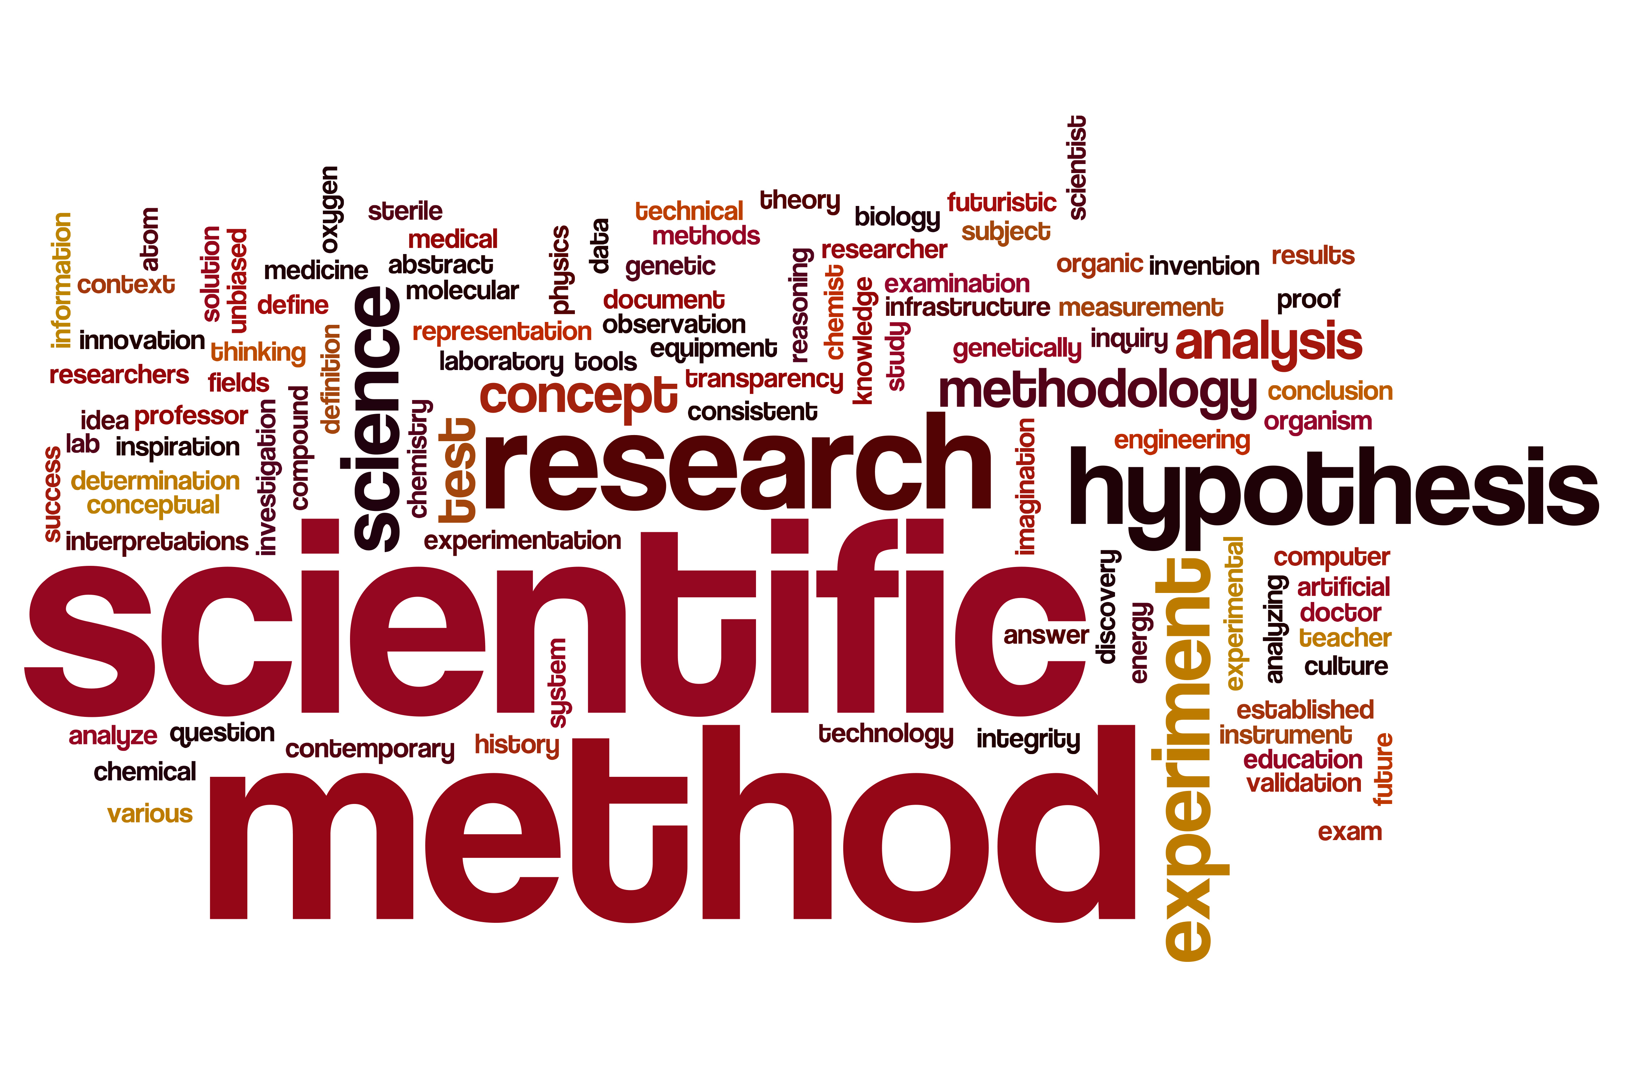
From the perspective of the Scientific Method

Slide 7
Basic Steps of the Scientific Method
Observe
Bench scale experiments observe neurotransmitters are associated with depression
Develop question ➔ Hypotheses
What if we alter these neurotransmitters, will it alleviate the symptoms of depression?
There is no difference in depression symptoms between the control group receiving the placebo and the treatment group receiving the new antidepressant drug
Design an experiment (replicate)
Randomly select sample from target population (adults suffering from depression) and randomly assign them to receive a control (placebo) or treatment (new drug)
Collect data (reproduce)
Analyze the data (reproduce)
Exploratory and confirmatory data analysis and inferential modeling.
Report conclusions (generalize) - Inferences extend to target group
Back to the drawing board

Slide 8
In the Context of the Clinical Trial
Generalizability refers to inferring from a sample to a target population - inductive reasoning - makes broad generalizations from specific observations (sample) to the target population
Replication: can the entire process be replicated by the same or different lab under identical conditions
Reproducibility: can the exact numerical results and inferences be reproduced by reanalyzing the same data
Would the person reanalyzing the data make the same decisions regarding outliers, transformations, modeling, analyses methods, etc. etc

Slide 9
What about In the context of a policy study
What happens when complex policy interventions are cast as simple treatments and the scientific method is employed?
The context in which the policy intervention takes place is the key to understanding when, how, for whom, and to what extent an intervention can be replicated and the results generalized.
Notes:
Context = demographic characteristics of the setting and the people in it, material and economic features, institutional and organizational climate, interpersonal dimensions or typical means of interactions and noms for relationships in the setting, and the political dynamics of the setting including issues and interests.

Slide 10
Basic Steps in the Context of ALL Data
Observe
Set social context for issue to be studied, articulate action space
Develop question
Use literature and best practices help formulate and refine questions, hypotheses, define and shape data discovery process
Design Experiment (replicate)
Data discovery process
Collect data (reproduce)
Data acquisition approach, data sharing agreements, etc.
Analyze the data (reproduce)
Disciplined approach to data repurposing, model development, and fitness-for-use assessments
Report conclusions (generalize)
Back to the drawing board

